Slide 1
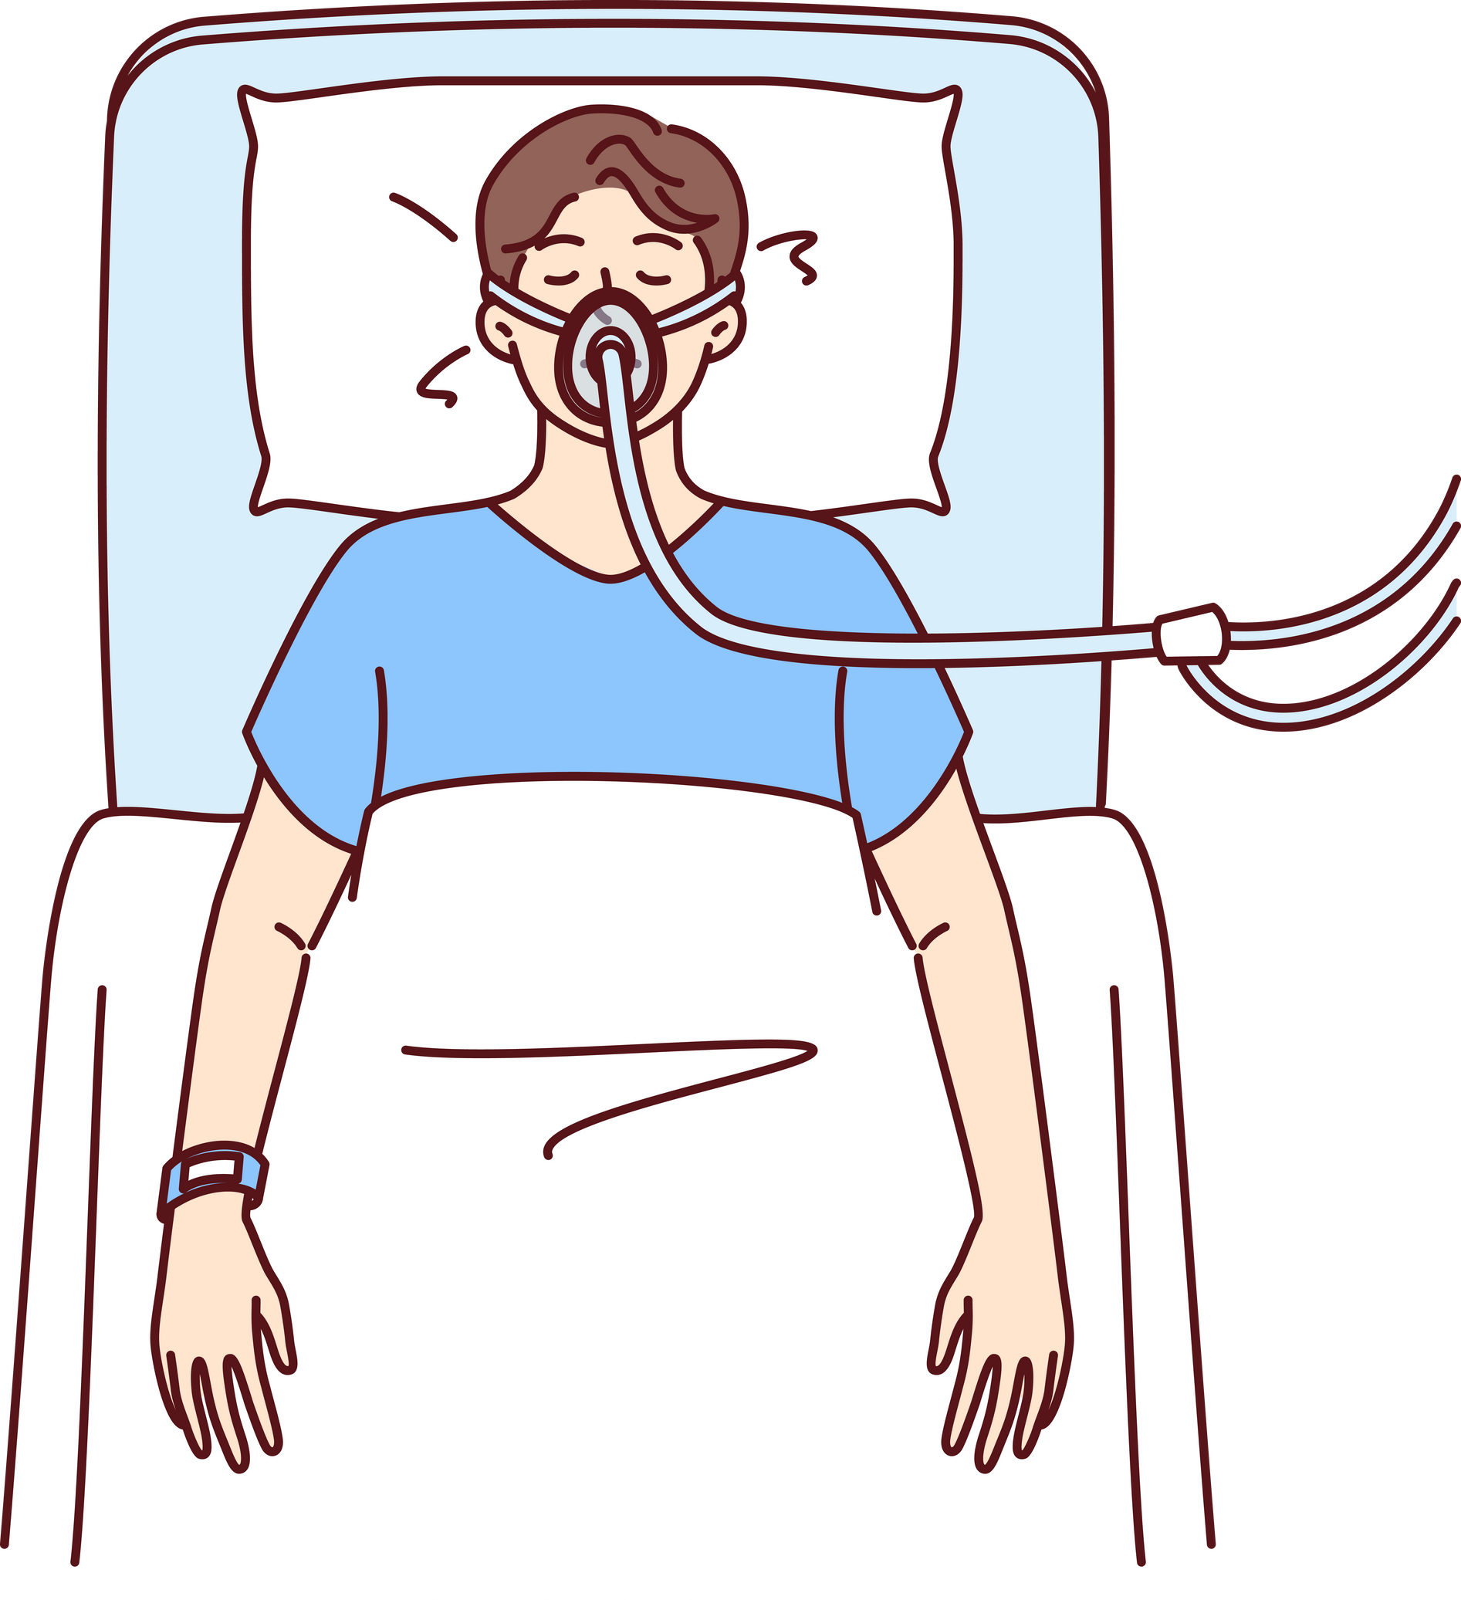
‘SLEEPSENTIEL’-
An IOT BASED SLEEP APNEA MONITORING DEVICE

Slide 2


OVERVIEW
ABSTRACT
INTRODUCTION
METHODOLOGY & MATERIALS
WORKING PROCEDURE
RESULT & ANALYSIS
CONCLUSION & FUTURE WORKS
COSTING & COMPARATIVE ANALYSIS

Slide 3




ABSTRACT
ADEQUATE SLEEP IS ESSENTIAL FOR HEALTHY LIFESTYLE
SLEEP APNEA ,A DISORDER ,RESULTS IS PHYSIOLOGICAL ALTERATIONS DURING SLEEP
PREVIOUSLY DEVELOPED DEVICES LACK THE CAPABILITY FOR REAL TIME MONITORING
SleepSentiel INCORPORATES A WEARABLE DEVICE DESIGNED TO CONTINUOUSLY MONITOR HEALTH CONDITIONS

Slide 4

INTRODUCTION
SleepSentiel OBSERVES HEART RATE,ECG & MOVEMENT
WEARABLE DEVICE GATHERS DATA & SENDS REAL TIME DATA TO A CENTRALIZED CLOUD PLATFORM
OFFER REMOTE ACCESSIBILITY & PROACTIVE APPROACH FOR HEALTHCARE PROVIDERS
EASY TO NAVIGATE & PRIORITIZE EARLY DETECTION OF HEALTH CONCERNS

Slide 5

METHODOLOGY & MATERIALS
METHODOLOGY
MICROCONTR-OLLER POSSESS WIFI CONNECTIVITY
CONNECTS INPUT & OUTPUT LAYER
INPUT LAYERS INCLUDE 3 SENSORS
OUTPUT LAYER INCLUDES MOBILE APPLICATION

Slide 6
OUTLINE OF THE SYSYTEM
HEART RATE PULSE SENSOR
AD8232 ECG SENSOR
ESP-32
Blynk app
ACCELEROMETER

Slide 7
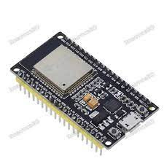

MODULES & MATERIALS
BUILT-IN WIFI WHICH TRANSMITS DATA, COLLECTED BY MONITORING DEVICE TO BLYNK APP

Slide 8
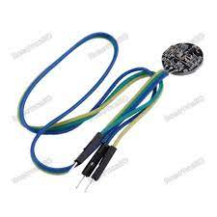

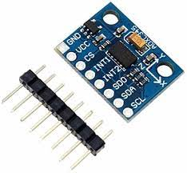
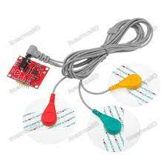
CAPTURES DETAILED WAVEFORM OF HEART’S ELECTRICAL ACTIVITY
DETECTS CHANGING HEART RATE DURING SLEEP APNEA EPISODES
MOVEMENT DATA CONTRIBUTES TO ASSESS SLEEP MONITORING

Slide 9
WORKING PROCEDURE
Power setup
Start
ESP32 module Pin setup
Loop
Sending app notification and Email to alert apnea
Read ‘Analog’ Data from AD8232 sensor(ECG) & convert them into digital data
Read ‘Analog’ Data from heart rate pulse sensor(BPM) & convert them into digital data
Read ‘Analog’ Data from Accelerometer sensor(motion in X, Y, Z plane) & convert them into digital data
Recognition Apnea conditions
Receive & merge data from all sensor
WIFI on
Showing real time data in ‘blynk App’
Storing data for further analysis

Slide 10
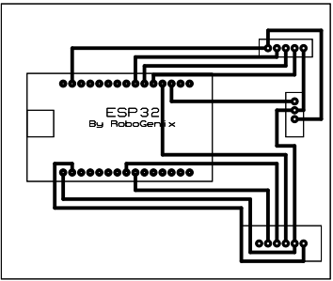
SCHEMATIC DIAGRAM OF PCB

Slide 11
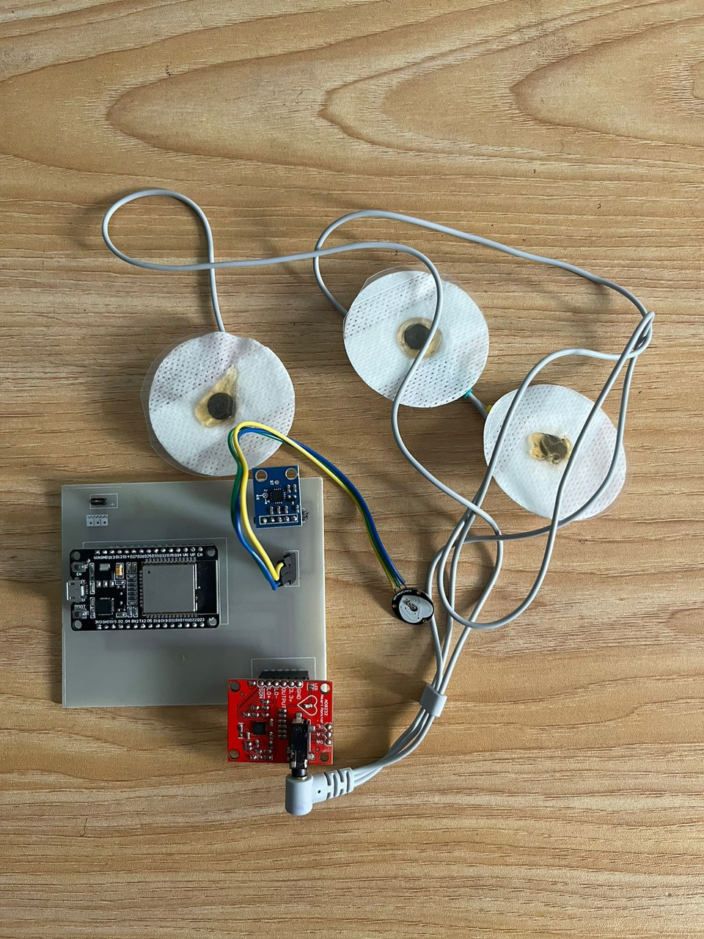
PCB IMPLEMENTATION

Slide 12
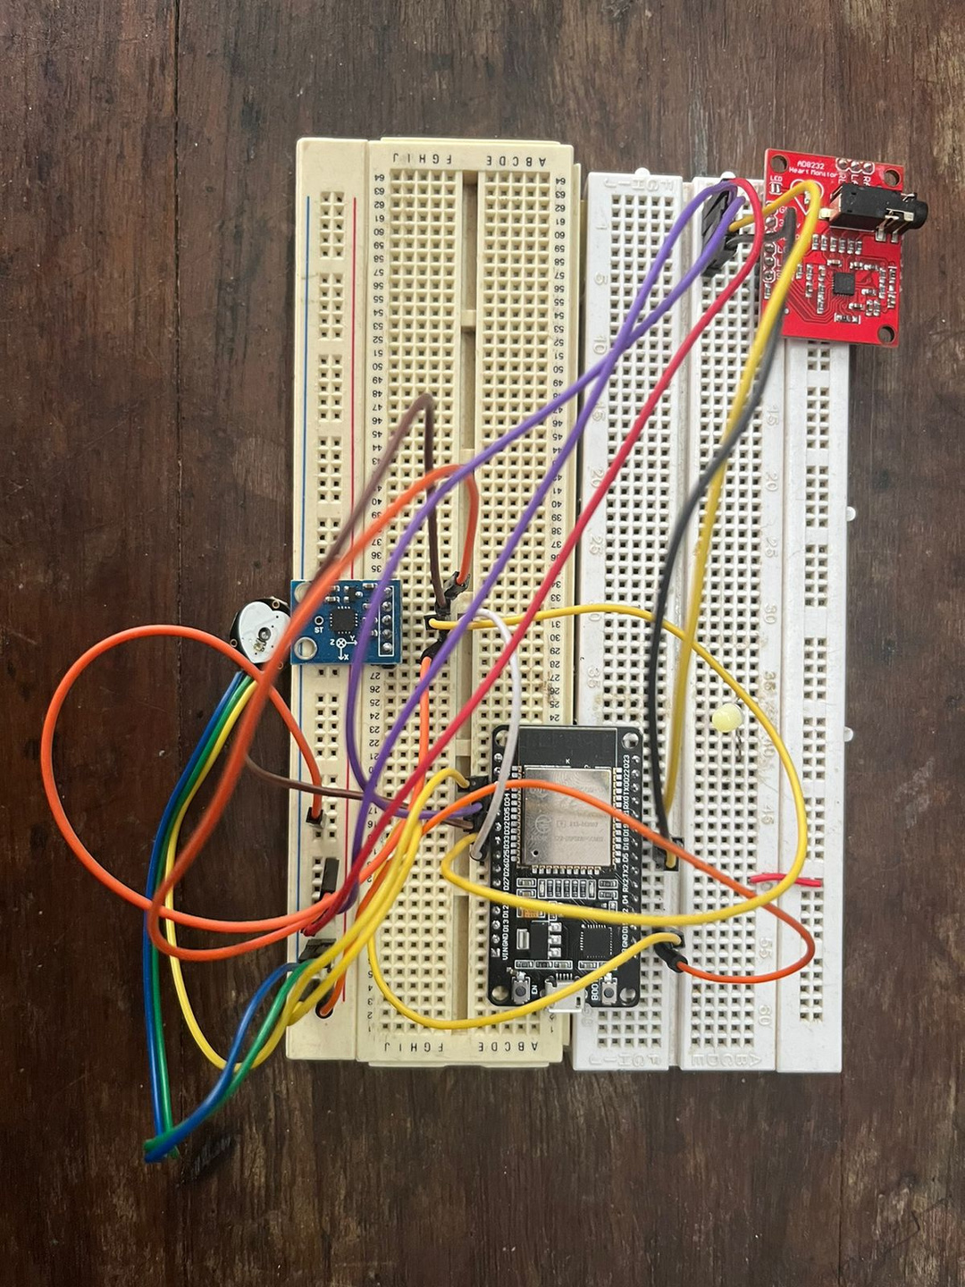
BREAD-BOARD IMPLEMENTATION

Slide 13

RESULT & ANALYSIS
HEART SENSOR- BPM,ECG SENSR - ECG WAVES & ACCELEROMETER-MOVEMENT
01
FLAT LINE SHOWN IN DATASHEET
WHILE BREATHING STOPS
02
03
IF BREATHING STOPS FOR 15 SEC -AN ALERT VIA MAIL SENT
COUNTING THE ALERT MESSAGE,INSTANCES OF HALTING BREATHS CAN BE TALLIED
04

Slide 14


DESIGN PROTOTYPE & VIEW OF REAL TIME DATA

Slide 15
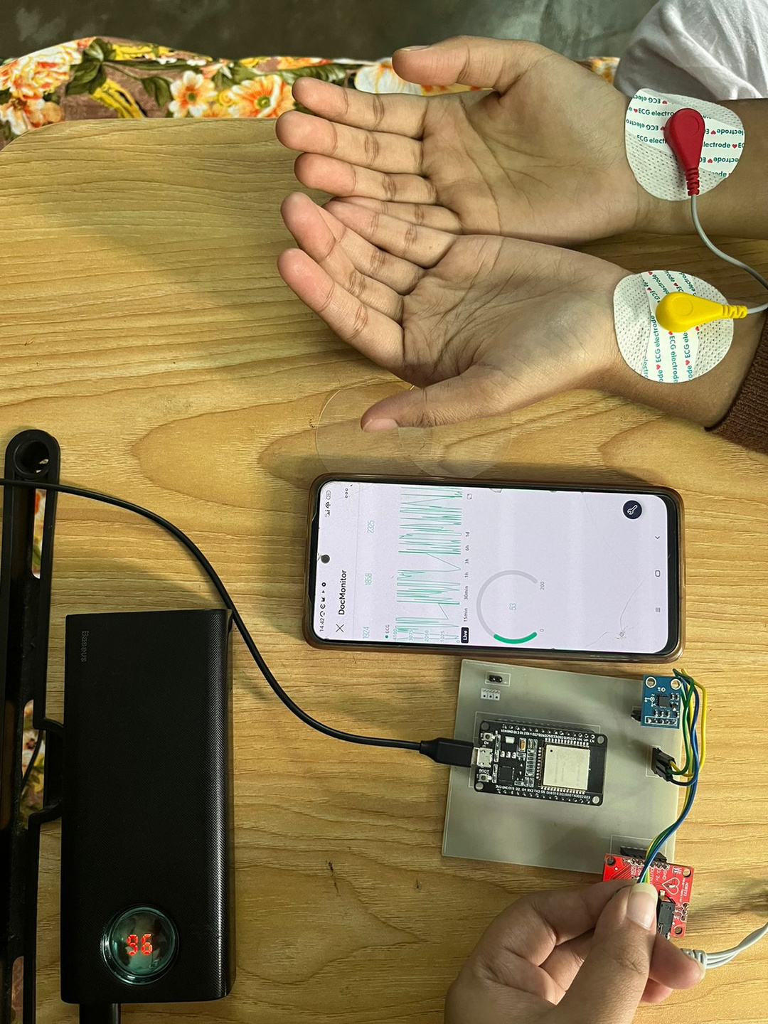
FIG : SENSORS ARE LINKED TO BODY

Slide 16
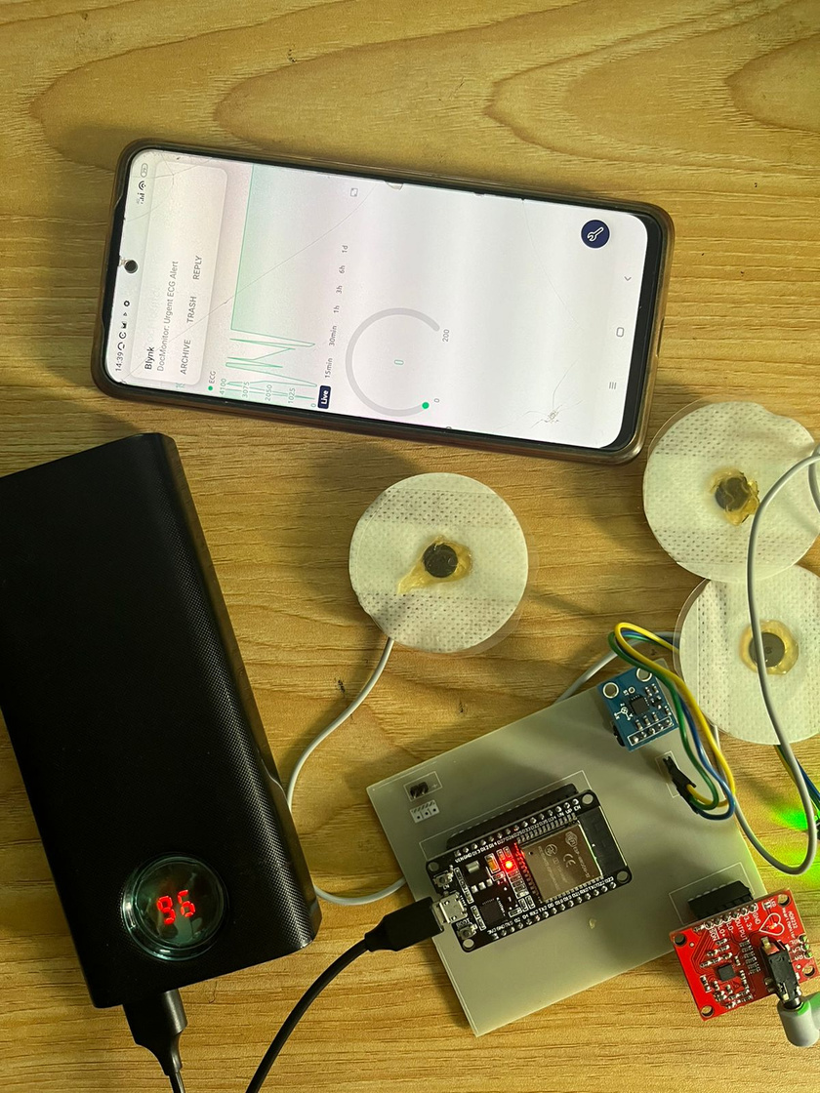
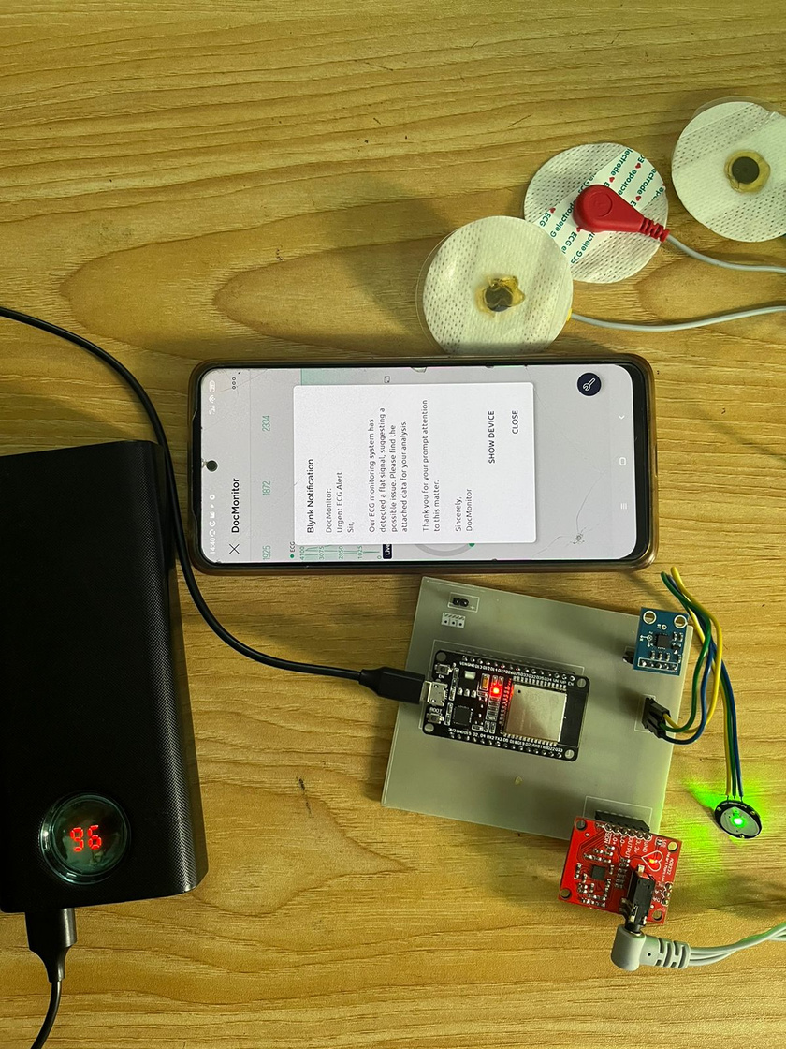
FIG : NO SENSORS ARE LINKED
FIG : MAIL IS SENT

Slide 17



COST & COMPARATIVE ANALLYSIS

Slide 18

COMPONENTS | QUANTITY | PRICE
HEART PULSE SENSOR | 1 | 280
AD8232 ECG SENSOR | 1 | 790
ADXL335- ACCELEROMETER | 1 | 700
ESP -32 | 1 | 500
PCB | 1 | 500
Female header | 4 | 60
COST

Slide 19



COMPARATIVE ANALYSIS
PREVIOUS MODELS
SleepSentiel
BASED ON ONE OR TWO PARAMETERS
ALERT SYSYTEM
MONITORS 3 HEALTH CONDITIONS SIMULTANEOUSLY
NO ALERT SYSYTEM
VIDEO REQUIRED

Slide 20

CONCLUSION & FUTURE WORK

Slide 21
CONCLUSION
DETECTION
SUSTAINIBILITY
EARLY DISCOVERY OF SLEEP DISORDER
DURATION OF SLEEP APNEA CAN BE IDENTIFIED
ACCESSIBILITY
INTEGRATION
PHYSICALLY DISABLED PEOPLE CAN ACCESS IT EASILY
ADDIITIONAL SENSORS CAN BE INCORPORATED TO ENHANCE SOPHISTICATION

Slide 22




PROSPECTIVE ENDEAVORS
SPO2 SENSOR
LOWER SP02 CAN BE DETECTED
ACCELEROMETER
ANALYSIS OF X,Y & Z PARAMETERS REVEAL PATIENT’S POSTURE

Slide 23
THANK YOU
PRESENTED BY-
SABICUNNAHAR
ID : 1911003
SAIFUL ISLAM SAIF
ID : 1911011
REYANA SHAHID
ID : 1911002

